Slide 1

 | Shri Shivaji Vidya Prasarak Sanstha’s Bapusaheb Shivajirao Deore Polytechnic, Dhule Academic Year : 2023 – 2024 Department of Computer Engineering
A seminar on Capstone Project Proposal (CPP-22058)
Topic |  | Student Academic Progress Management
Presented by |  | 1.Badgujar Mohit Hemant
 |  | 2.Bhat Atharva Yogesh
 |  | 3.Deore Samarthya Ravindra
 |  | 4.Makhija Dhruv Harish
Guided by |  | Mr. C. P. Bhamare
Semester |  | 5 I | Date : 14 / 10 / 2023

Slide 2
Content
1. Abstract
2. Introduction and Background of the Industry
3. Literature Survey
3.1 Study of existing system / Review of Research Papers
3.2 Limitations of existing system / Problems discussed in research papers
3.3 Problem Identification /need of a system
3.4 Problem Definition
4. Specifications
4.1 User Requirements
4.2 System Requirements
5. Proposed Detailed Methodology of solving indentified problem
5.1 Proposed work
5.2 Proposed Design
6. Week wise Action Plan – for Sixth semester
7. References and Bibliography

Slide 3
1. Abstract
Educational institutions are facing challenges in managing student data, such as Attendance, Submissions(Assignments and Practical), class-test marks, Timetable and Submission Report. Manual data entry and processing can be time-consuming, error-prone, and inefficient.
We will design our website to address the administrative and data management needs of educational institutions. It computerize student data including Attendance, Submissions(Assignments and Practical), class-test marks, Timetable and Submission Report reducing manual workloads and errors.

Slide 4
2. Introduction
Attendance, Class-test Marks, Submission Report, Timetable, Assignments And Practical Submissions plays an important role to manage student record.
To manage the records manually is difficult, time consuming and causes lack of accuracy and data loss.
To overcome these problems, we aim to computerize all the student record and make it easy for college faculty to manage and keep backup of these data.
Where as for students, they can view there attendance(theory and practical), class-test marks, class wise timetable, submission report, assignments and practical submissions.

Slide 5
3. Literature Survey
3.1 Study of existing system / Review of Research Papers
In our college attendance is taken by calling roll no. and fills up the presenty in the muster table, which is time consuming.
Assignment details are managed by filling up the submission muster which make it hard to gather the details.

Slide 6
3. Literature Survey
The marks of the conducted class test’s are filled up in the muster, which may consume time and also makes hard to access the marks when needed .
Creating the submission report can be a time-consuming and tiring task for students, as they are required to collect faculty signatures for approval.

Slide 7
3. Literature Survey
3.2 Limitations of existing system / Problems discussed in research papers
Lack of real-time attendance tracking, leading to potential inaccuracies and delays in updating attendance records.
Challenges in tracking and managing the submission of assignments , practical, including lack of traceability and may cause error.

Slide 8
3. Literature Survey
3.3 Problem Identification /need of a system
In the current system, the use of paper-based attendance sheets is done to maintain student records, leading to difficulties and issues in management.
Keepings records of student in paper-sheets files with less accuracy resulting in misplaced of files, damaged files or even results in data loss. Such records are hard to retrieve, and are Time consuming. Also when in emergencies.

Slide 9
3. Literature Survey
As manually keeping records of students Attendance, test marks, practical marks which are on papers, musters does not have any backups causes it to have big loss of data in any circumstances
To Overcome the problem of student data management regarding student attendance, Assignment & Practical submissions, class Test marks, Timetable.

Slide 10
3. Literature Survey
3.4 Problem Definition
The Proposed system is a web application which will be design for managing student attendance (theory and practical), test record(Class test 1 and 2), submission record(assignment and practical). To make the Student Record management easy.

Slide 11
4. Specification
4.1 User Requirements :
Student:
Attendance (Number of Lectures Attended): Keeping a record of the number of lectures and Practical a student has attended.
Submissions (Assignments and Practical): Tracking the submission of assignments and practical work by students.
Timetable: A schedule showing when classes, lectures and other educational activities take place.

Slide 12
4. Specification
Class Test Marks (1st and 2nd): Recording the marks obtained by a student in class tests.
Gathering feedback from students on the quality of teaching and the facilities available for their education.
Submission Report (No dues).
Notes or resources shared by teachers to assist students in their learning.
Letter to HOD for personal or emergency reasons.

Slide 13
4. Specification
Overall Report:
Total percentage of attendance: Calculating the overall percentage of lectures and Practical attended by a student.
Marks obtained by student in Class Test 1 and 2.
Submissions Report (No dues, Assignment, Practical).
Teachers Remark: Comments or feedback provided by teachers regarding a student's performance or behaviour in class.

Slide 14
4. Specification
4.2 System Requirements:
Operating System: Windows OS
RAM: 2 GB(Min)
Processor: Intel Core i3
Platform: Visual Studio Code
Programming Language: HTML, CSS, JavaScript, Php
Framework: Bootstrap
Database: XAMPP(MySql, Apache)

Slide 15
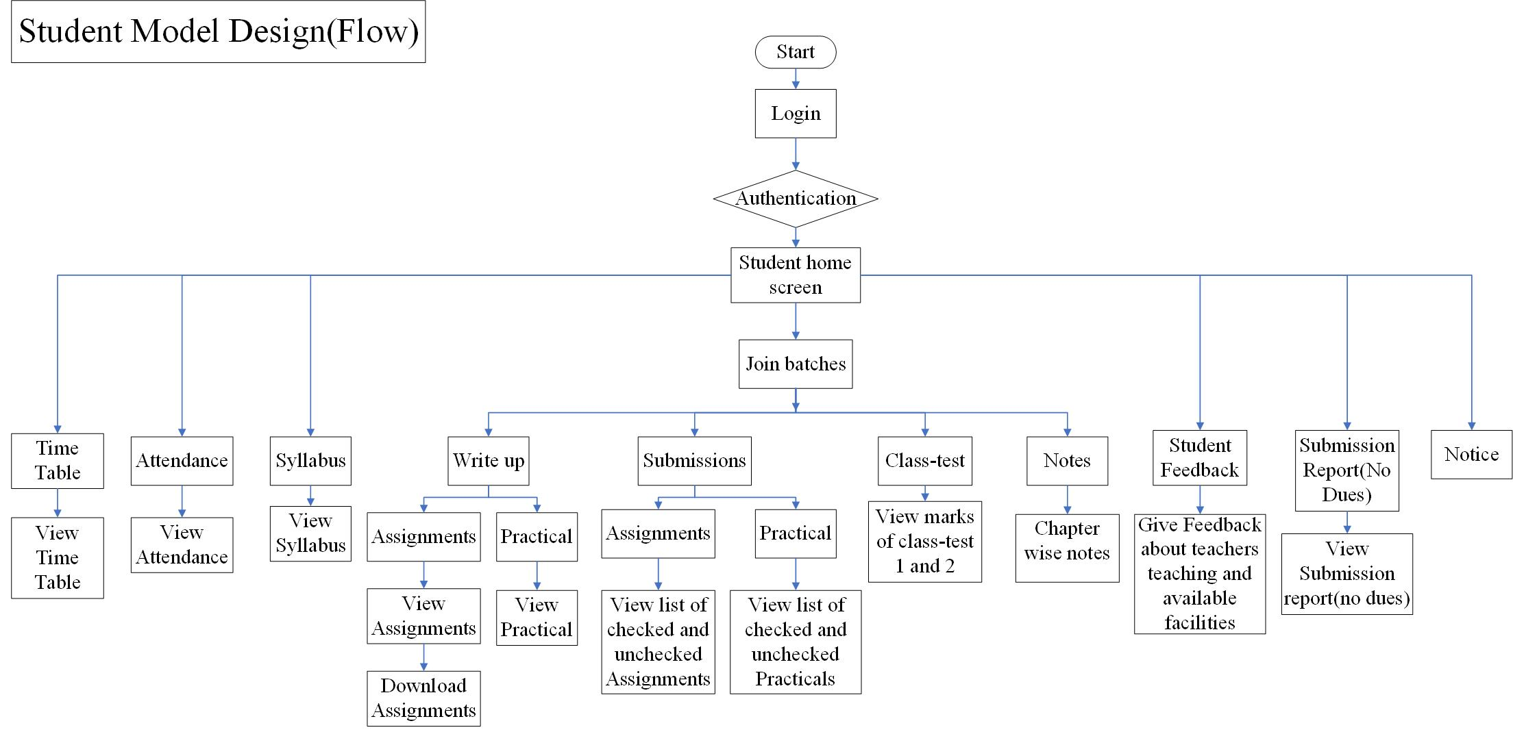
5.1 Proposed work

Slide 16
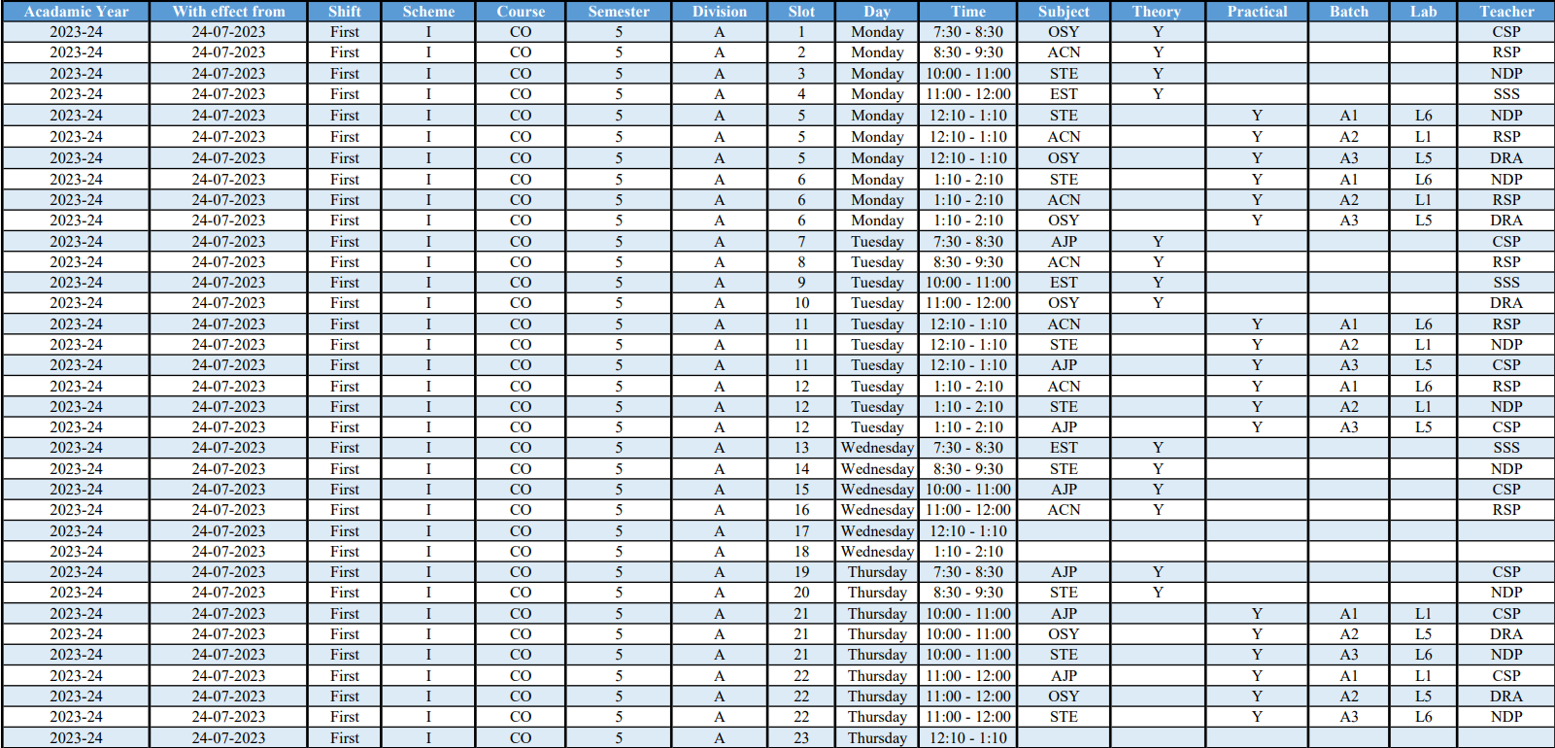
5.1 Proposed work(Attendance Database Design)

Slide 17
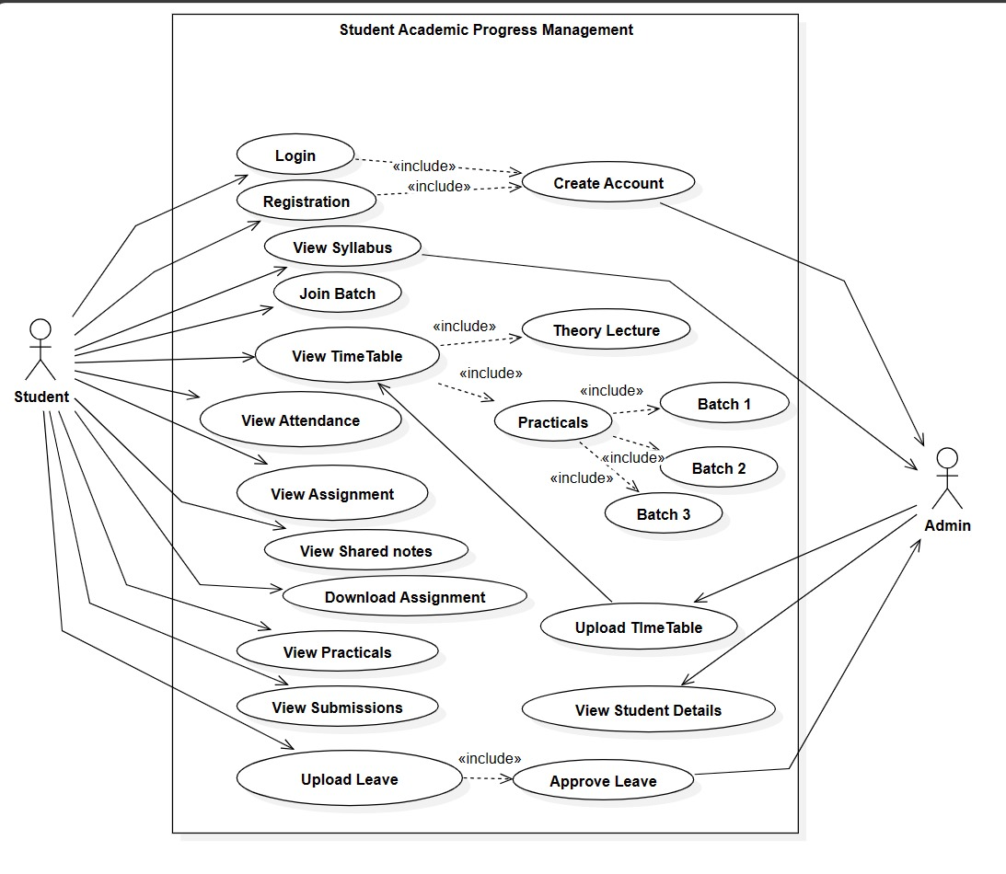
5.2 Proposed Design(Use-Case Diagram)

Slide 18
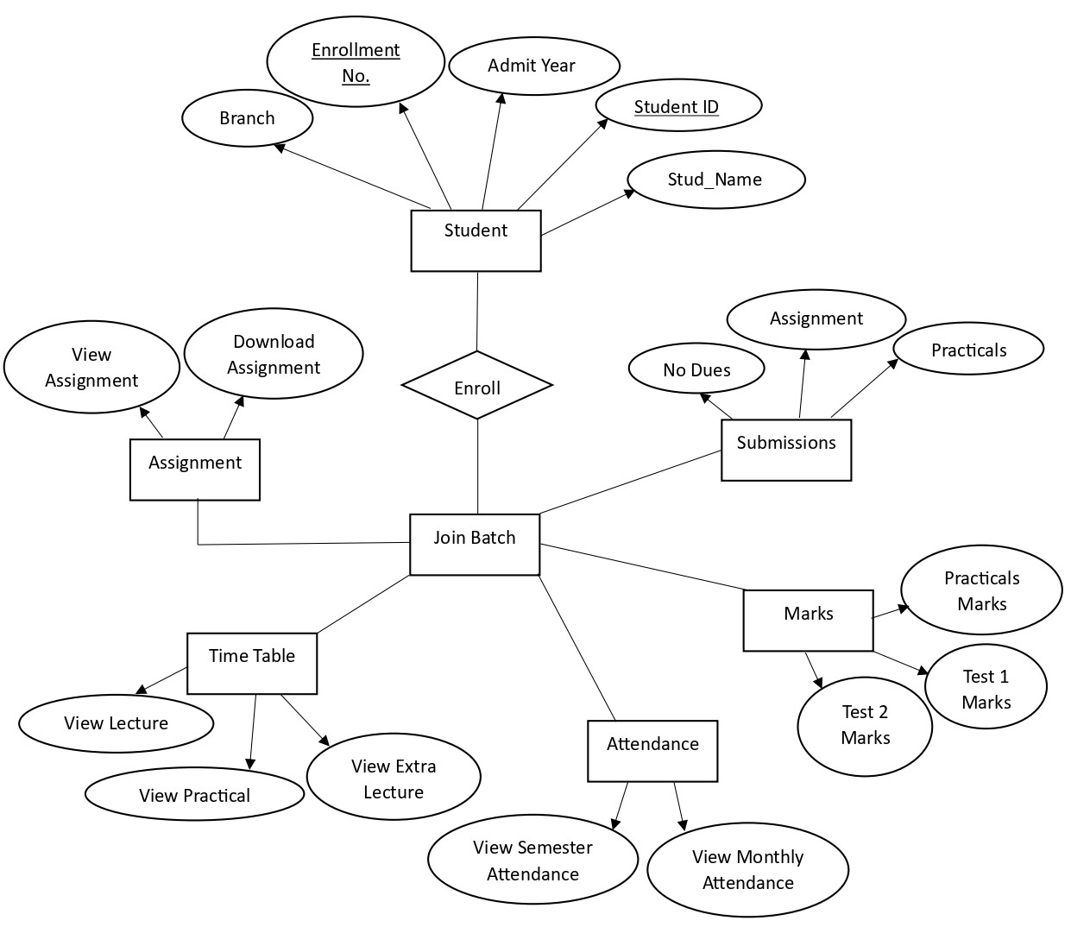
5.2 Proposed Design(Entity Relationship Diagram)

Slide 19
6. Week wise Action Plan – for Sixth semester
Sr. No. | List of Activities | Week | Dates
1 | Design User Interface | Week 1 | 01/01/2024 to 06/01/2024
2 | Design database structure, create database | Week 2 | 07/01/2024 to 13/01/2024
3 | Develop GUI and various Interfaces | Week 3 | 14/01/2024 to 20/01/2024
4 | Programming / coding , database connectivity, if required | Week 4 | 21/01/2024 to 27/01/2024
 |  | Week 5 | 28/01/2024 to 03/02/2024
5 | Installation of Project, Dummy Data Entry | Week 6 | 04/02/2024 to 10/02/2024
6 | Testing | Week 7 | 11/02/2024 to 17/02/2024
7 | Modifications (if any required) | Week 8 | 18/02/2024 to 24/02/2024
8 | Project Report Writing | Week 9 | 25/02/2024 to 02/03/2024
9 | Submission of project report | Week 10 | 03/03/2024 to 09/03/2024

Slide 20
7. References and Bibliography
Student record management system:
https://www.iitms.co.in/blog/student-record-management-system.html
The Use of existing systems Student record management:
https://www.google.com/amp/s/www.softwaresuggest.com/blog/student-record-management-system/amp/
GitHub Repository:
https://github.com/kishanrajput23/Student-Information-System

Slide 21
Thank You!!

